Slide 1

Mobile App For External Customers
Feb 2019

Slide 2
Objectives For Customers’ Mobile App
To provide mobility to external customers to access SO status easily in local prefer language without the need to remember password securely
As a mobile marketing platform to external customers
To help us to promote APRIL digital branding
To leverage on the same platform to build even more digital capabilities to serve external customers better

Slide 3
One Time 3 Simple Registration Steps
A list of customers / particular are captured in the backend by admin. Customers only need to download the mobile app from App Store or Google Play Store to activate
Once open the app it will pop up a usage term & condition. Once agree customer will input individual mobile no & email. SMS will be sent to customer to activate the mobile app
Customer is ready to use the mobile app
1
2
3

Slide 4
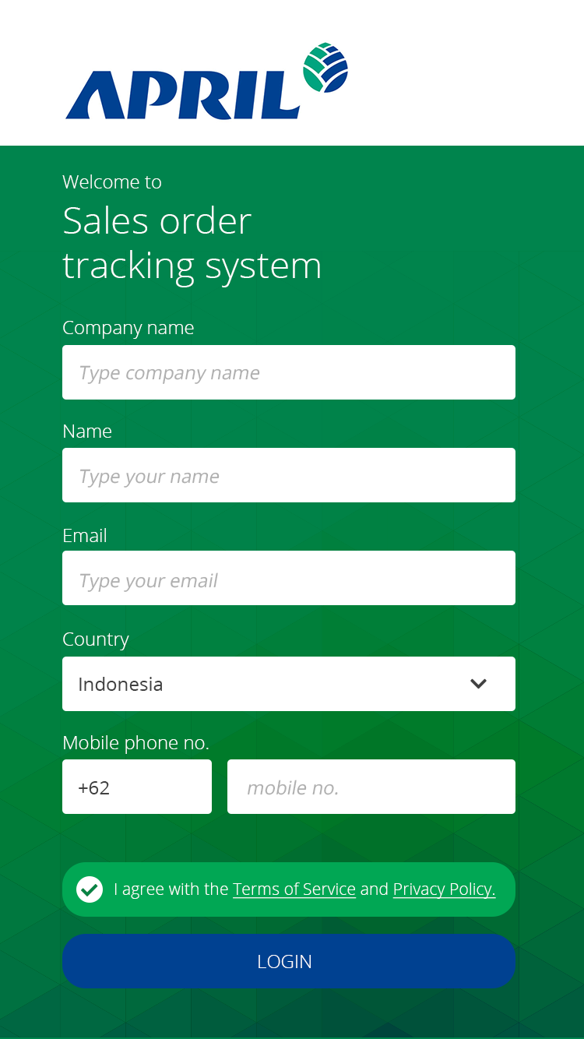
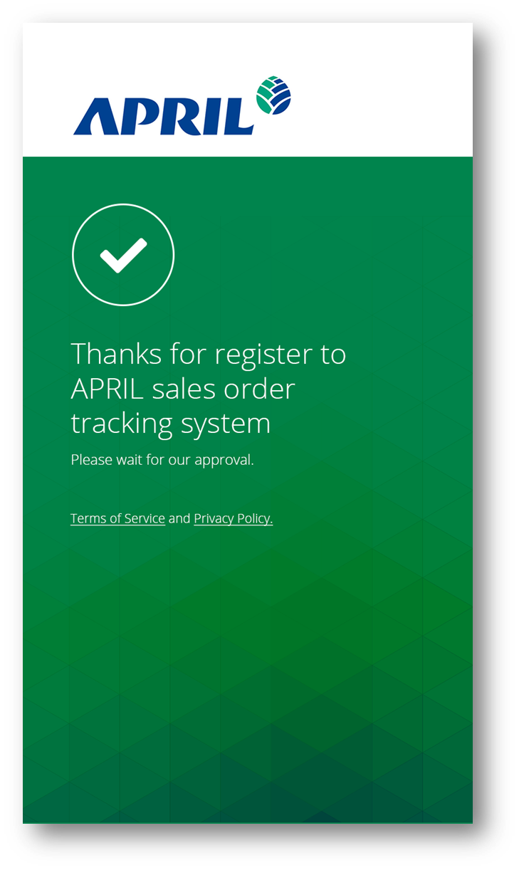
Screen Shot For Registration

Slide 5
2 Steps For SO Inquiry
Option to enter specific Customer’s Purchase Oder / APRIL’s Sales Order number or retrieve all Sales Orders by default
All or specific SO will only be retrieved only with the valid OTP
Before customer login to mobile app, he/she will receive a one time email/SMS OTP to login when open up the mobile app
1
2
3
*The mobile app will automatically logout after a configurable idle time for example 15 mins

Slide 6
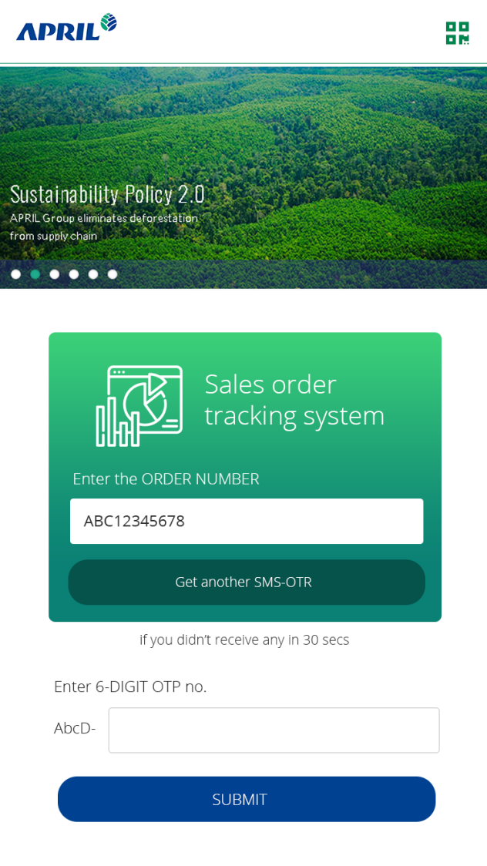
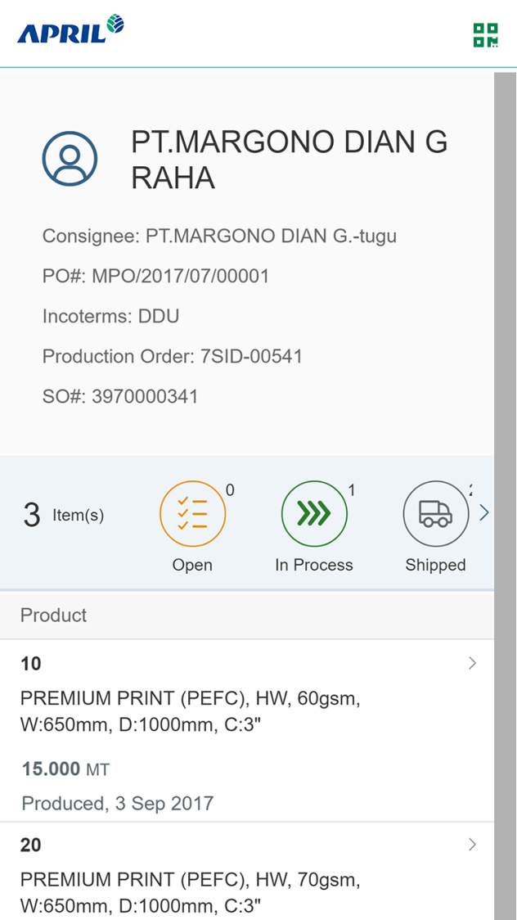
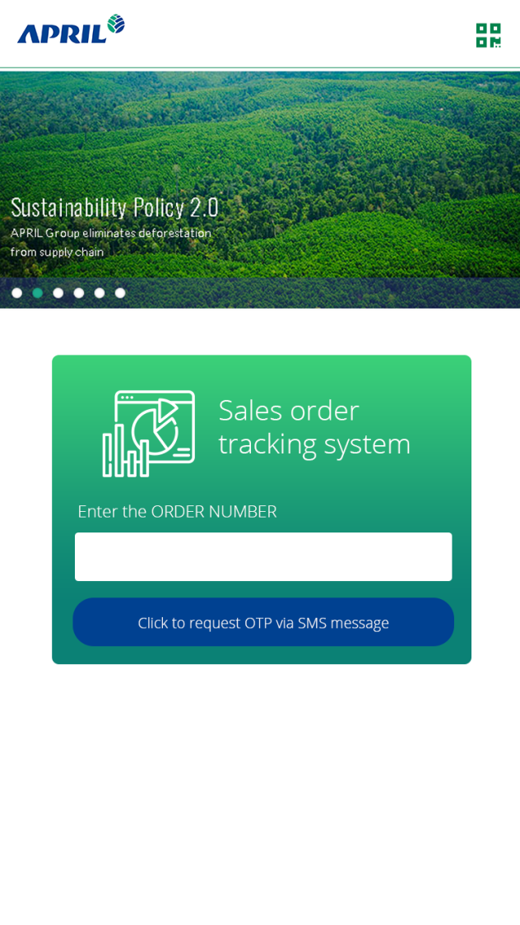
Screen Shots For SO Inquiry

Slide 7
2 Simple Steps For Marketing Banners Access
Customer can click on the running marketing banner on the top
It will bring the customer to the designated website / video / audio / forms effortlessly
1
2
Website
Video
Audio
Approach:
Phase 1 – Each banner can only link to a single source
Phase 2 – Max 3 sources can be linked via a different template that can host at the banner
Forms

Slide 8
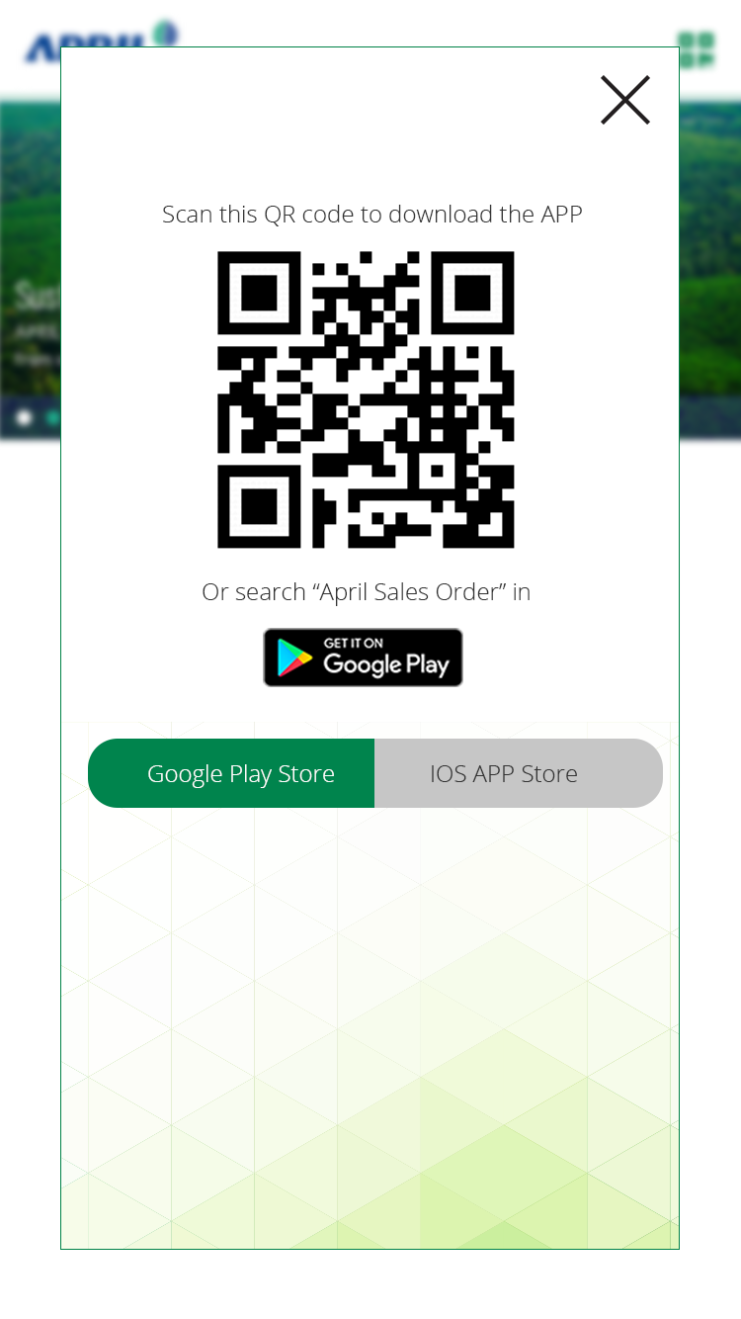
Single Step For Mobile App Download Via QR Code
We can make it simple for customers to download during sales or marketing events by merely scanning the QR Code
1

Slide 9
Estimated Investment / Timeline
Actions | Estimated Timeline / Investment
Deliver for testing | 30th April 2019 (if we confirm our requirements before 22nd Feb 2019)
One time development | USD 38K
There is a need to calculate the potential ROI (quantitative or qualitative) for us
A marketing video should be created for customers to promote the mobile app usage

Slide 10
Q & A

